Slide 1

Algorithm Design Paradigms
Dynamic Programming
19CSE201 Advanced Programming

Slide 2
0/1 Knapsack Problem
In 0/1 Knapsack Problem,
As the name suggests, items are indivisible here.
We cannot take the fraction of any item.
We have to either take an item completely or leave it completely.
It is solved using dynamic programming approach.
θ(nw) time is taken to solve 0/1 knapsack problem using dynamic programming

Slide 3
Steps to solve using Dynamic Programming
Consider a Knapsack of
weight capacity = w
Number of items =n
each having some weight and value
0/1 knapsack problem is solved using dynamic programming in the following steps

Slide 4
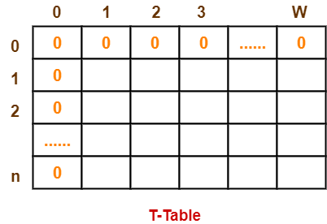
Step-01:
Draw a table say ‘T’ with (n+1) number of rows and (w+1) number of columns.
Fill all the boxes of 0th row and 0th column with zeroes as shown-

Slide 5
Step-02:
Start filling the table row wise top to bottom from left to right.
Use the following formula-
T (i , j) = max { T ( i-1 , j ) , valuei + T( i-1 , j – weighti ) }
Here, T(i , j) = maximum value of the selected items if we can take items 1 to i and have weight restrictions of j.
This step leads to completely filling the table.
Then, value of the last box represents the maximum possible value that can be put into the knapsack.

Slide 6
Step-03:
To identify the items that must be put into the knapsack to obtain that maximum profit,
Consider the last column of the table.
Start scanning the entries from bottom to top.
On encountering an entry whose value is not same as the value stored in the entry immediately above it, mark the row label of that entry.
After all the entries are scanned, the marked labels represent the items that must be put into the knapsack.

Slide 7
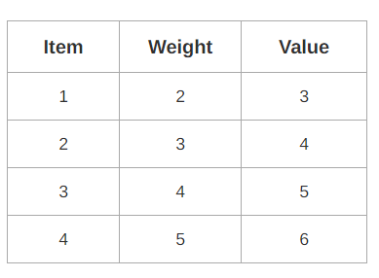
Example
For the given set of items and knapsack capacity = 5 kg, find the optimal solution for the 0/1 knapsack problem making use of dynamic programming approach.

Slide 8
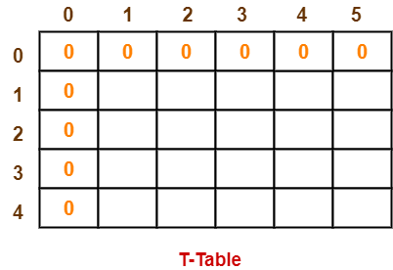
Example contd.
Step-01:
Draw a table say ‘T’ with (n+1) = 4 + 1 = 5 number of rows and (w+1) = 5 + 1 = 6 number of columns.
Fill all the boxes of 0th row and 0th column with 0.

Slide 9
Example contd.
Start filling the table row wise top to bottom from left to right using the formula-
Finding T(1,1)
We have,
i = 1
j = 1
(value)i = (value)1 = 3
(weight)i = (weight)1 = 2
Substituting the values, we get-
T(1,1) = max { T(1-1 , 1) , 3 + T(1-1 , 1-2) }
T(1,1) = max { T(0,1) , 3 + T(0,-1) }
T(1,1) = T(0,1) { Ignore T(0,-1) }
T(1,1) = 0

Slide 10
Finding T(1,2)-
We have,
i = 1
j = 2
(value)_{i} = (value)₁ = 3
(weight)_{i} = (weight)₁ = 2
Substituting the values, we get-
T(1,2) = max { T(1-1 , 2) , 3 + T(1-1 , 2-2) }
T(1,2) = max { T(0,2) , 3 + T(0,0) }
T(1,2) = max {0 , 3+0}
T(1,2) = 3

Slide 11
Finding T(1,3)-
We have,
i = 1
j = 3
(value)_{i} = (value)₁ = 3
(weight)_{i} = (weight)₁ = 2
Substituting the values, we get-
T(1,3) = max { T(1-1 , 3) , 3 + T(1-1 , 3-2) }
T(1,3) = max { T(0,3) , 3 + T(0,1) }
T(1,3) = max {0 , 3+0}
T(1,3) = 3

Slide 12
Finding T(1,4)-
We have,
i = 1
j = 4
(value)_{i} = (value)₁ = 3
(weight)_{i} = (weight)₁ = 2
Substituting the values, we get-
T(1,4) = max { T(1-1 , 4) , 3 + T(1-1 , 4-2) }
T(1,4) = max { T(0,4) , 3 + T(0,2) }
T(1,4) = max {0 , 3+0}
T(1,4) = 3

Slide 13
Finding T(1,5)-
We have,
i = 1
j = 5
(value)_{i} = (value)₁ = 3
(weight)_{i} = (weight)₁ = 2
Substituting the values, we get-
T(1,5) = max { T(1-1 , 5) , 3 + T(1-1 , 5-2) }
T(1,5) = max { T(0,5) , 3 + T(0,3) }
T(1,5) = max {0 , 3+0}
T(1,5) = 3

Slide 14
Finding T(2,3)-
We have,
i = 2
j = 3
(value)i = (value)2 = 4
(weight)i = (weight)2 = 3
Substituting the values, we get-
T(2,3) = max { T(2-1 , 3) , 4 + T(2-1 , 3-3) }
T(2,3) = max { T(1,3) , 4 + T(1,0) }
T(2,3) = max { 3 , 4+0 }
T(2,3) = 4

Slide 15
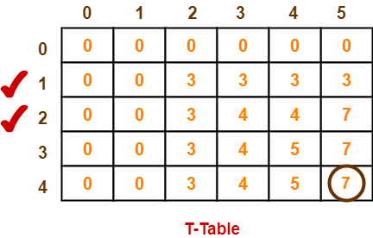
Similarly, compute all the entries.
After all the entries are computed and filled in the table, we get the following table-
The last entry represents the maximum possible value that can be put into the knapsack.
So, maximum possible value that can be put into the knapsack = 7.

Slide 16
Identifying Items To Be Put Into Knapsack-
Following Step-03,
We mark the rows labelled “1” and “2”.
Thus, items that must be put into the knapsack to obtain the maximum value 7 are-
Item-1 and Item-2

